Slide 1


Slide 2

6
GOVERNMENT ACTIONS IN MARKETS

Slide 3
After studying this chapter you will be able to
Explain how rent ceilings create housing shortages and inefficiency
Explain how minimum wage laws create unemployment and inefficiency
Explain the effects of a tax
Explain the effects of production quotas and subsidies on production, costs, and prices
Copyright © 2013 Pearson Canada Inc., Toronto, Ontario

Slide 4
In Vancouver, where many people earn $10 an hour, condominiums rents start at $1,000 a month.
Can governments cap rents to help renters?
Can governments make housing more affordable by raising incomes with minimum wage laws?
The government taxes almost everything we buy.
But who actually pays and who benefits when a tax is cut: buyers or sellers?
The government limits the quantities that some farmers may produce and subsidizes other farmers.
Do production limits and subsidies help to make markets efficient?
Copyright © 2013 Pearson Canada Inc., Toronto, Ontario

Slide 5
A Housing Market with a Rent Ceiling
  A price ceiling or price cap is a regulation that makes it illegal to charge a price higher than a specified level.
  When a price ceiling is applied to a housing market it is called a rent ceiling.
  If the rent ceiling is set above the equilibrium rent, it has no effect. The market works as if there were no ceiling.
  But if the rent ceiling is set below the equilibrium rent, it has powerful effects.
Copyright © 2013 Pearson Canada Inc., Toronto, Ontario

Slide 6
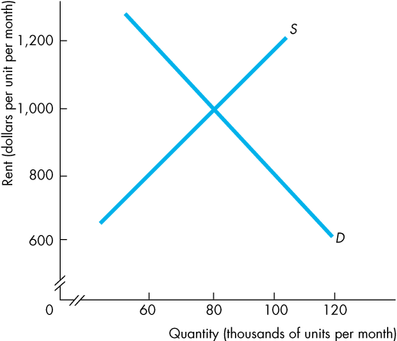
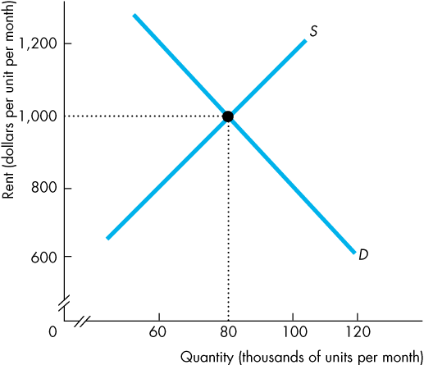
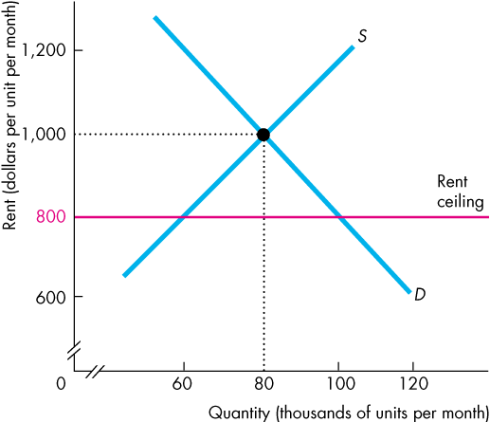
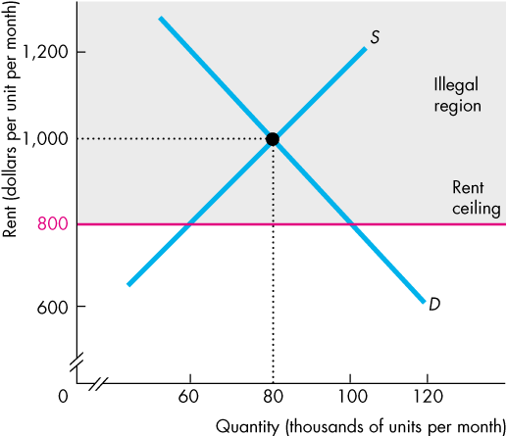
A Housing Market with a Rent Ceiling
  Housing Shortage
  Figure 6.1 shows the effects of a rent ceiling that is set below the equilibrium rent.
  The equilibrium rent is $1,000 a month.
  A rent ceiling is set at $800 a month.
  So the equilibrium rent is in the illegal region.

Slide 7
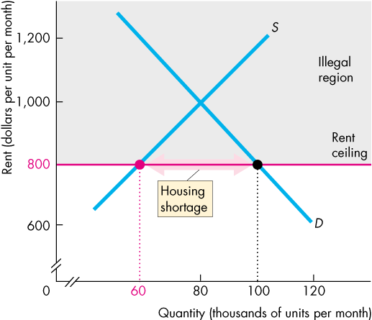
A Housing Market with a Rent Ceiling
  At the rent ceiling, the quantity of housing demanded exceeds the quantity supplied.
  There is a shortage of housing.
Copyright © 2013 Pearson Canada Inc., Toronto, Ontario

Slide 8
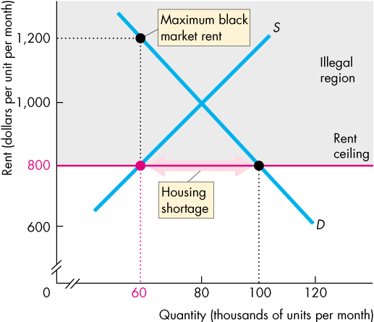
A Housing Market with a Rent Ceiling
  Because the legal price cannot eliminate the shortage, other mechanisms operate:
  Increased search
  activity
  A black market
  With the shortage, someone is willing to pay up to $1,200 a month.
Copyright © 2013 Pearson Canada Inc., Toronto, Ontario
Notes:
To rent the 60,000th unit, someone is willing to pay $1,200 a month. They might pay this amount by incurring seach costs that bring the total cost of housing to $1,200 a month, or they might pay a black market price of $1,200 a month.

Slide 9
A Housing Market with a Rent Ceiling
A Black Market
  A black market is an illegal market that operates alongside a legal market in which a price ceiling or other restriction has been imposed.
  A shortage of housing creates a black market in housing.
  Illegal arrangements are made between renters and landlords at rents above the rent ceiling—and generally above what the rent would have been in an unregulated market.

Slide 10
A Housing Market with a Rent Ceiling
Inefficiency of a Rent Ceiling
  A rent ceiling set below the equilibrium rent leads to an inefficient underproduction of housing services.
  The marginal social benefit from housing services exceeds its marginal social cost and a deadweight loss arises.
  Figure 6.2 illustrates this inefficiency.

Slide 11
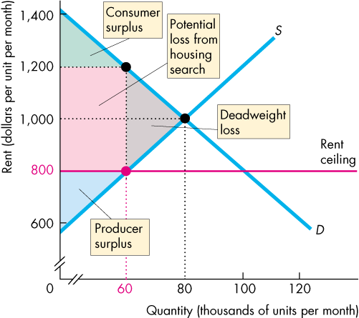
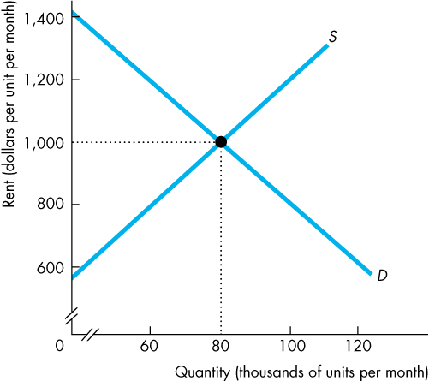
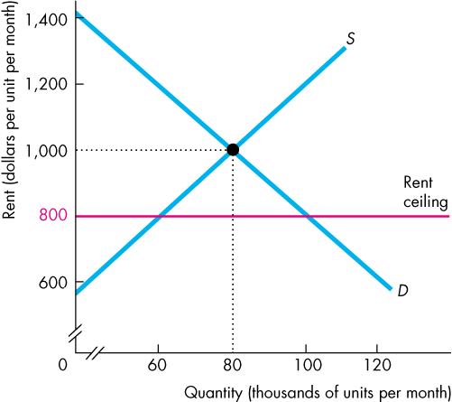
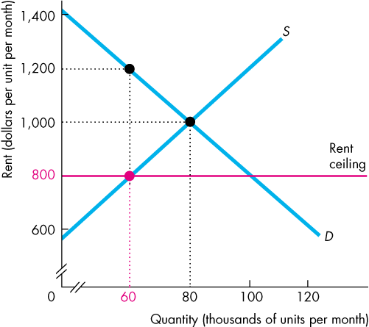
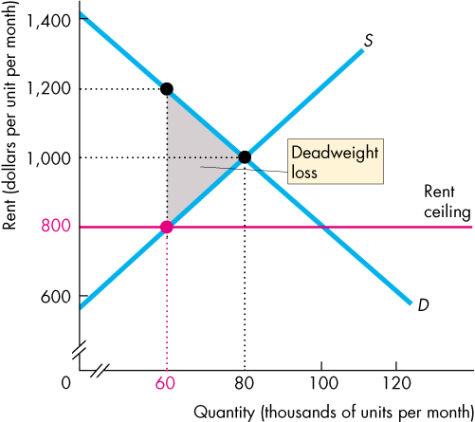
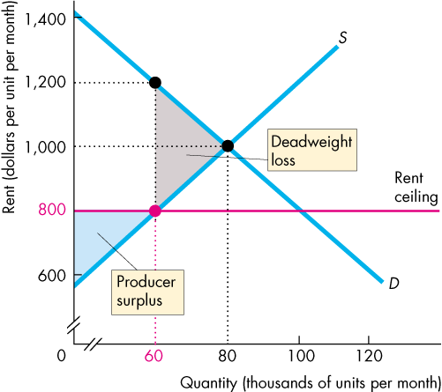
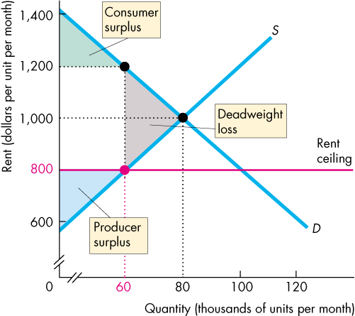
A Housing Market with a Rent Ceiling
  A rent ceiling decreases the quantity of housing supplied to less than the efficient quantity.
  A deadweight loss arises.
  Producer surplus shrinks.
  Consumer surplus shrinks.
  There is a potential loss from increased search activity.
Notes:
Efficiency of markets:
An efficient market (one that maximizes net social benefits; equivalently, one that maximizes total surplus) performs 3 important functions:
It allocates consumption of the good to buyers who most value it (i.e those with the highest willingness to pay; equivalently, those with the highest marginal benefit).
It allocates production of the good to sellers who are most efficient at producing it (i.e. those with the lowest willingness to receive; equivalently, those who have the lowest cost)
It ensures that every consumer who makes a purchase values the good more than every seller who makes a sale, so that all transactions are mutually beneficial (i.e. there is a net benefit from exchange; equivalently, all transactions are mutually beneficial so there is a total surplus from exchange).
As a result of these three functions, any way of allocating the good other than the market equilibrium outcome lowers net benefits or total surplus and generates a deadweight loss.
The housing shortage can lead to inefficiency in three distinct ways:
It reduces the quantity of rental units below the efficient level, and so causes a loss of net benefits (or equivalently, a loss in total surplus). In the market after a rent ceiling, consumer surplus is the green triangle plus the pink rectangle; producer surplus is the lower blue triangle.
It can lead to misallocation of the rental units to buyers who do not benefit from them the most (i.e. at a rent ceiling of $800, there are 100,000 buyers, but the first 60,000 buyers along the market demand curve – those who most value the rental units - are not necessarily those receiving the rental units – the rental units may be rented to any 60,000 buyers along the demand curve between the origin and 100,000 who are willing to pay a least $800 per unit). This misallocation further adds to the deadweight loss from rent ceilings.
It can lead to wasted resources as people expend money, effort, and time (i.e. search costs) to cope with the shortages caused by the price ceiling. The opportunity cost of search are forgone consumption of other goods enjoyed, wages not earned, leisure time not enjoyed. Individuals would otherwise have been better off if the market for rental units worked freely, enabling them to find rental units quickly at the equilibrium rent of $1,000, leaving them time to earn more or to enjoy themselves – an outcome that would make them better off . The maximum individuals would be willing to expend on search is the consumer surplus they would receive from the unit (i.e. the green triangle plus the pink rectangle). The resources wasted in searching for the good reduces total surplus and adds to the deadweight loss from rent ceilings.
Rent ceilings also lead to illegal activities, specifically the emergence of black markets. Clearly, there is a temptation for a landlord to say to a potential tenant, “Look, you can have the place if you slip me an extra few hundred in cash each month” – and for the tenant to agree if he is one of those people who would be willing to pay much more than the maximum legal rent. If all 60,000 units were rented on the black market for a single black market equilibrium price, then the rent for a unit would be $1,200. Black markets transfer surplus from buyers to sellers (i.e. the pink area of consumer surplus is now transferred to sellers as increased producer surplus), so the emergence of these markets do not add to the deadweight loss from rent ceilings. Then what’s wrong with black markets? In general, it’s a bad thing because it encourages disrespect for the law, and it may not be equitable because illegal activity may worsen the position of those least well off (i.e. those who rent ceilings were designed to help) who are unable to afford to ‘bribe’ landlords to rent out a unit.

Slide 12
A Housing Market with a Rent Ceiling
Are Rent Ceilings Fair?
  According to the fair rules view, a rent ceiling is unfair because it does not allow for equality of opportunity (equal access).
  According to the fair results view, a rent ceiling is unfair because it does not generally benefit the poor.
  A rent ceiling decreases the quantity of housing and the scarce housing is allocated by
  Lottery
  First-come, first-served
  Discrimination

Slide 13
A Housing Market with a Rent Ceiling
  If a fair outcome is defined as one that benefits the less well off (that is, the poor), then
  A lottery gives scarce housing to the lucky, not to those who are poor.
  A first-come, first served gives scarce housing to those who have the greatest foresight and get their names on the list first, not to the poorest.
  Discrimination gives scarce housing to friends, family members, or those of the selected race or sex.
  None of these methods necessarily allocates scarce housing to the less well off, so they are not necessarily fair.

Slide 14
A Labour Market with a Minimum Wage
  A price floor is a regulation that makes it illegal to trade at a price lower than a specified level.
  When a price floor is applied to labour markets, it is called a minimum wage.
  If the minimum wage is set below the equilibrium wage rate, it has no effect. The market works as if there were no minimum wage.
  If the minimum wage is set above the equilibrium wage rate, it has powerful effects.

Slide 15
A Labour Market with a Minimum Wage
  Minimum Wage Brings Unemployment
  If the minimum wage is set above the equilibrium wage rate, the quantity of labour supplied by workers exceeds the quantity demanded by employers.
  There is a surplus of labour.
  The quantity of labour hired at the minimum wage is less than the quantity that would be hired in an unregulated labour market.
  Because the legal wage rate cannot eliminate the surplus, the minimum wage creates unemployment.

Slide 16
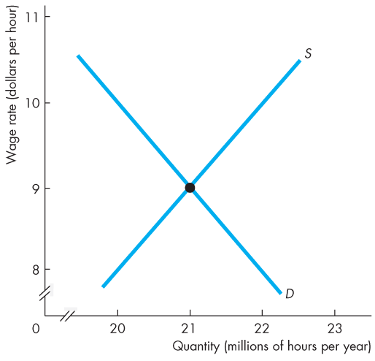
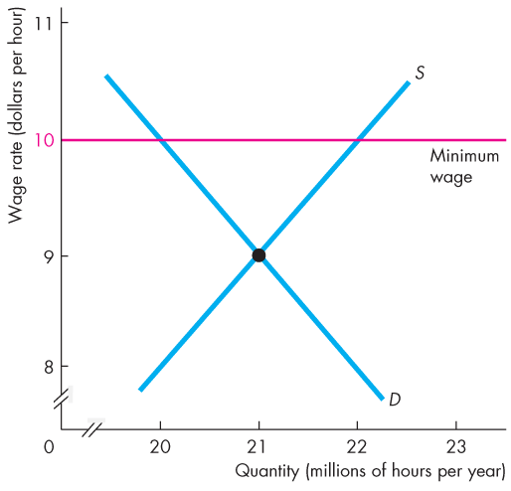
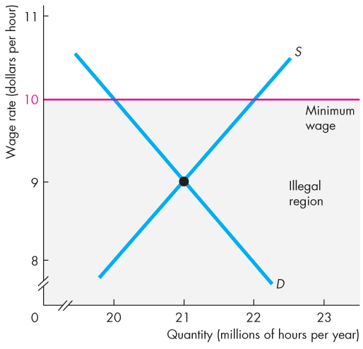
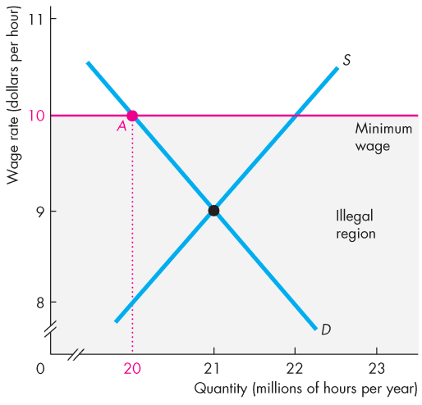
A Labour Market with a Minimum Wage
  The equilibrium wage rate is $9 an hour.
  The minimum wage rate is set at $10 an hour.
  So the equilibrium wage rate is in the illegal region.
  The quantity of labour employed is the quantity demanded.

Slide 17
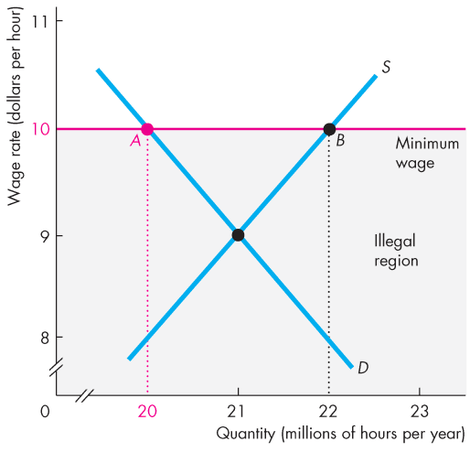
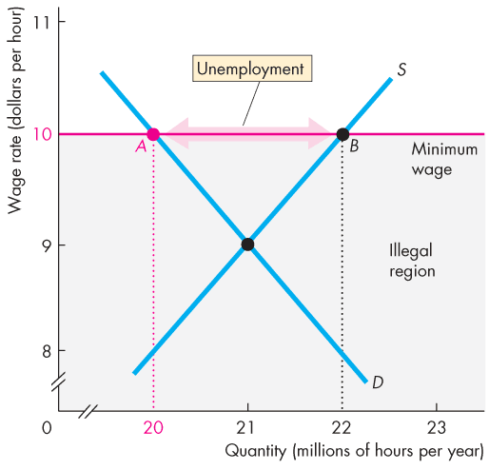

A Labour Market with a Minimum Wage
  The quantity of labour supplied exceeds the quantity demanded and unemployment is created.
  With only 20 million hours demanded, some workers are willing to supply the last hour demanded for $8.
Copyright © 2013 Pearson Canada Inc., Toronto, Ontario

Slide 18
A Labour Market with a Minimum Wage
Inefficiency of a Minimum Wage
  A minimum wage leads to an inefficient outcome.
  The quantity of labour employed is less than the efficient quantity.
  The supply of labour measures the marginal social cost of labour to workers (leisure forgone).
  The demand for labour measures the marginal social benefit from labour (value of goods produced).
  Figure 6.4 illustrates this inefficient outcome.

Slide 19
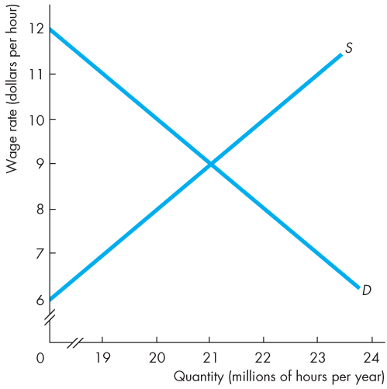
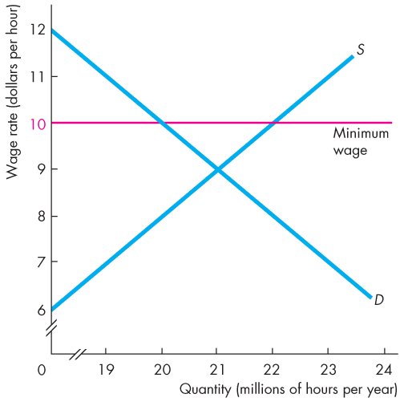
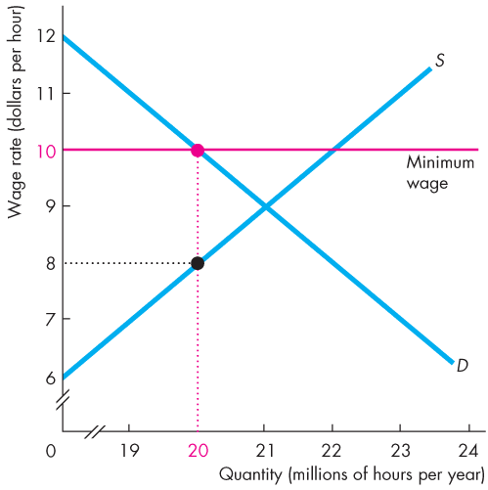
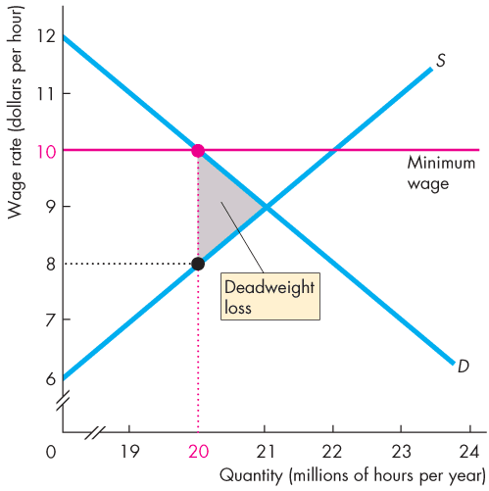
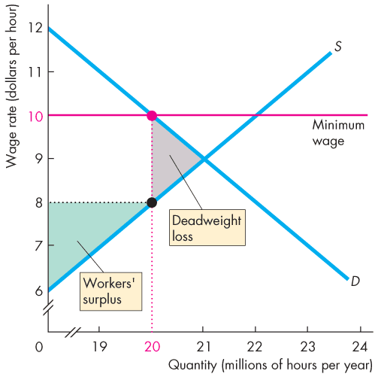
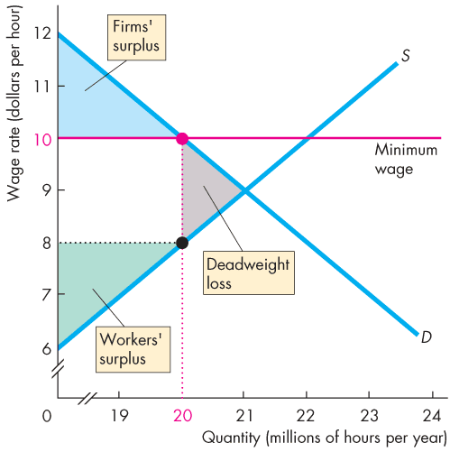
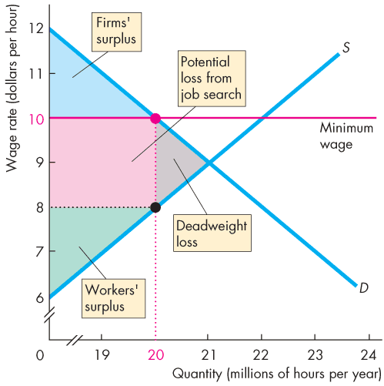
A Labour Market with a Minimum Wage
  A minimum wage set above the equilibrium wage decreases the quantity of labour employed.
  A deadweight loss arises.
  The potential loss from increased job search decreases workers’ surplus.
  The full loss is the sum of the red and grey areas.
Notes:
The employment shortage can lead to inefficiency in three distinct ways:
It reduces the quantity of employment below the efficient level, and so causes a loss of net benefits (or equivalently, a loss in total surplus). In the market after a minimum wage, consumer (or employer) surplus is the upper blue triangle; producer (or employee) surplus is the lower green triangle plus the pink rectangle.
It can lead to misallocation of employment among sellers who would be willing to work for less money - equivalently, supply their labour at a lower opportunity (i.e. at a minimum wage of $10, there are 22 million sellers, but the first 20 million seller hours along the market supply curve – those who have the lowest opportunity cost - are not necessarily those supplying the labour – employment may be given to any 20 million sellers along the supply curve between the origin and 22 million who are willing to receive a least $10). This misallocation further adds to the deadweight loss from minimum wages.
It can lead to wasted resources as people expend money, effort, and time (i.e. search costs) to cope with the shortage of employment caused by the minimum wage. The opportunity cost of search are forgone consumption of other goods enjoyed, wages not earned, leisure time not enjoyed. Individuals would otherwise have been better off if the market for employment worked freely, enabling them to find employment quickly at the equilibrium wage of $9, leaving them time and money to spend on other things – an outcome that would make them better off . The maximum individuals would be willing to expend on search is the producer (or employee) surplus they would receive from employment (i.e. the lower green triangle plus the pink rectangle). The resources wasted in searching for employment reduces total surplus and adds to the deadweight loss from minimum wages.
Minimum wages also lead to illegal activities, specifically the emergence of black labour markets. Clearly, workers desperate for jobs may agree to work off the books for employers who conceal their employment from the government. If all 20 million sellers were employed on the black labour market for a single black market equilibrium price, then the wage would be $8. Black labour markets transfer surplus from sellers to buyers buyers (i.e. the pink area of producer (or employee) surplus is now transferred to buyers (or employers) as increased consumer (or employer) surplus), so the emergence of these markets do not add to the deadweight loss from minimum wages.

Slide 20
A Labour Market with a Minimum Wage
Is the Minimum Wage Fair?
  A minimum wage rate in Canada is set by the provincial governments.
  In 2011, the minimum wage rate ranged from a low of $8.75 an hour in British Columbia to a high of $11.00 an hour in Nunavut.
  Most economists believe that minimum wage laws increase the unemployment rate of low-skilled younger workers. These workers are therefore made worse off than they would be with no minimum wage, which may be an unfair result.

Slide 21
Taxes
  Everything you earn and most things you buy are taxed.
  Who really pays these taxes?
  Income taxes and the social security taxes are deducted from your pay, and HST (or GST) is added to the price of the things you buy, so isn’t it obvious that you pay these taxes?
  Isn’t it equally obvious that your employer pays the employer’s contribution to the social security tax?
  You’re going to discover that it isn’t obvious who pays a tax and that lawmakers don’t decide who will pay!

Slide 22
Taxes
Tax Incidence
  Tax incidence is the division of the burden of a tax between buyers and sellers.
  When an item is taxed, its price might rise by the full amount of the tax, by a lesser amount, or not at all.
  If the price rises by the full amount of the tax, buyers pay the tax.
  If the price rise by a lesser amount than the tax, buyers and sellers share the burden of the tax.
  If the price doesn’t rise at all, sellers pay the tax.

Slide 23
Taxes
  Tax incidence doesn’t depend on tax law!
  The law might impose a tax on buyers or sellers, but the outcome will be the same.
  To see why, we look at the tax on cigarettes in Ontario.
  On February 1, 2006, Ontario raised the tax on the sales of cigarettes by $3.00 a pack of 25.
  What are the effects of this tax?

Slide 24
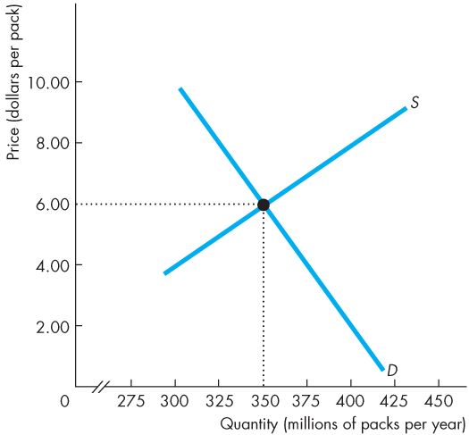
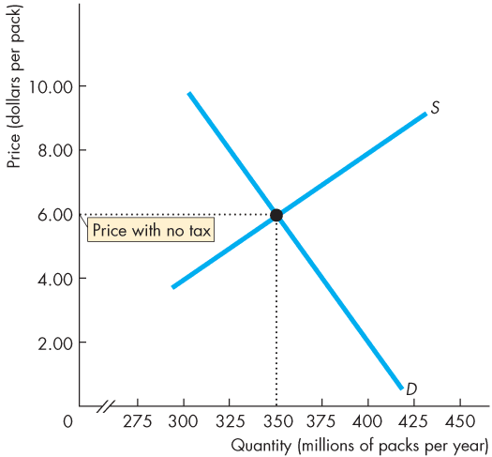
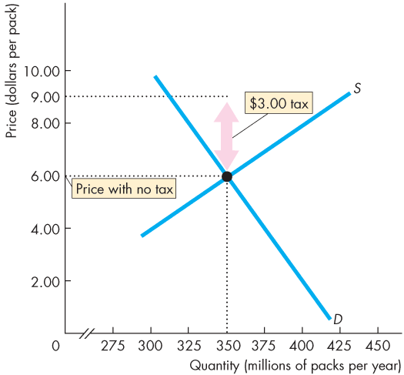
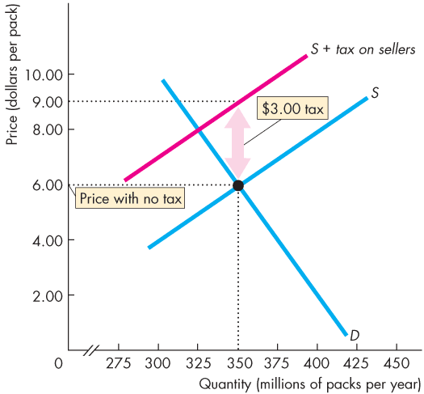
Taxes
A Tax on Sellers
  Figure 6.5 shows the effects of this $3 a pack tax.
  With no tax, the equilibrium price is $6 a pack.
  A tax on sellers of $3 a pack is introduced.
  Supply decreases and the curve S + tax on sellers shows the new supply curve.

Slide 25
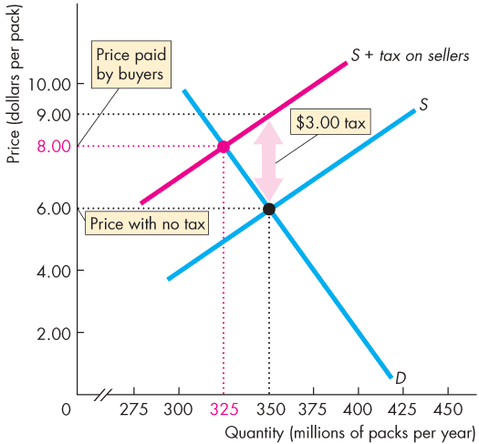
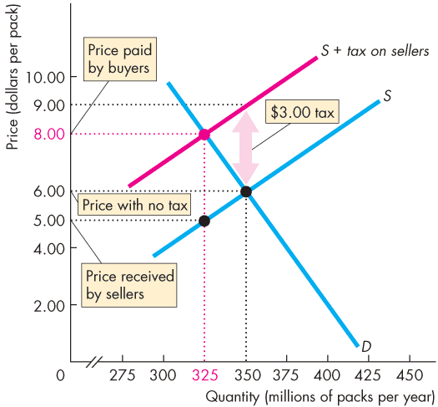
Taxes
  The market price paid by buyers rises to $8 a pack and the quantity bought decreases.
  The price received by the sellers falls to $5 a pack.
  So with the tax of $3 a pack, buyers pay $2 a pack more and sellers receive $1 a pack less.
Copyright © 2013 Pearson Canada Inc., Toronto, Ontario

Slide 26
Taxes
  Tax Incidence and Elasticity of Demand
  The division of the tax between buyers and sellers depends on the elasticities of demand and supply.
  To see how, we look at two extreme cases.
  Perfectly inelastic demand: Buyers pay the entire tax.
  Perfectly elastic demand: Sellers pay the entire tax.
  The more inelastic the demand, the larger is the buyers’ share of the tax.

Slide 27
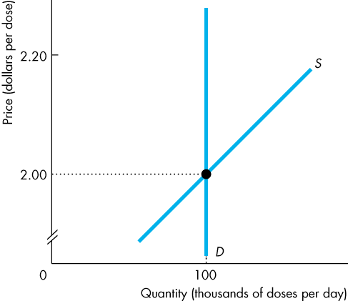
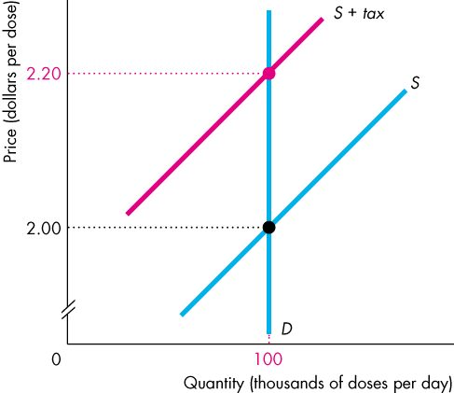
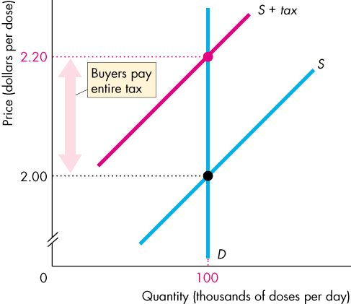
Taxes
  Perfectly Inelastic Demand
  Demand for this good is perfectly inelastic—the demand curve is vertical.
  When a tax is imposed on this good, buyers pay the entire tax.

Slide 28
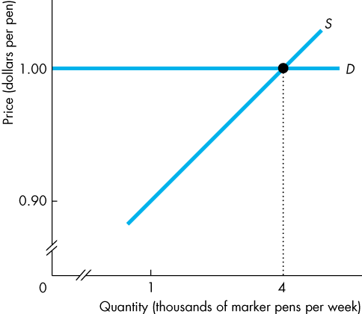
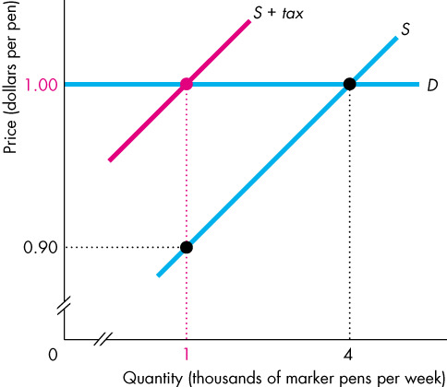
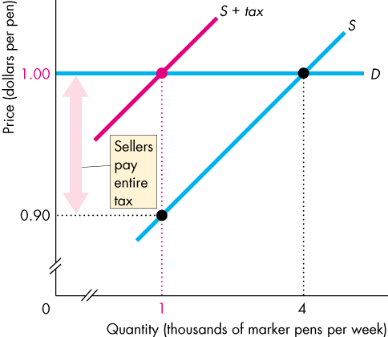
Taxes
  Perfectly Elastic Demand
  The demand for this good is perfectly elastic—the demand curve is horizontal.
  When a tax is imposed on this good, sellers pay the entire tax.

Slide 29
Taxes
Tax Incidence and Elasticity of Supply
  To see the effect of the elasticity of supply on the division of the tax payment, we again look at two extreme cases.
  Perfectly inelastic supply: Sellers pay the entire tax.
  Perfectly elastic supply: Buyers pay the entire tax.
  The more elastic the supply, the larger is the buyers’ share of the tax.

Slide 30
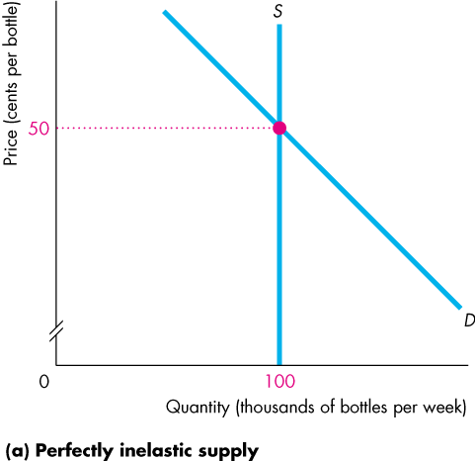
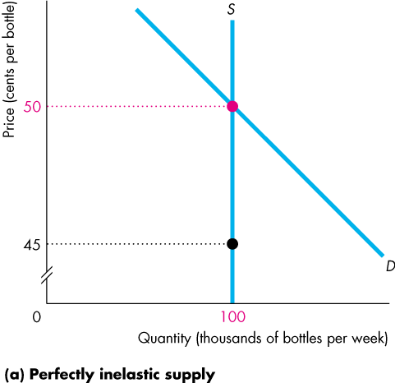
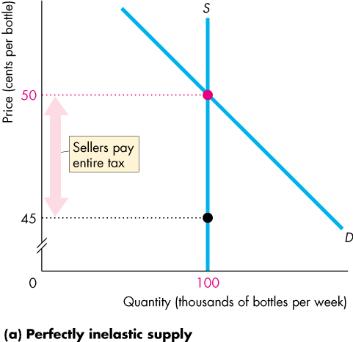
Taxes
  Perfectly Inelastic Supply
  The supply of this good is perfectly inelastic—the supply curve is vertical.
  When a tax is imposed on this good, sellers pay the entire tax.

Slide 31
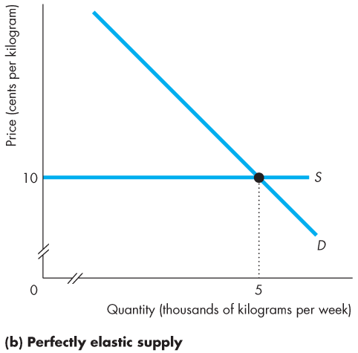
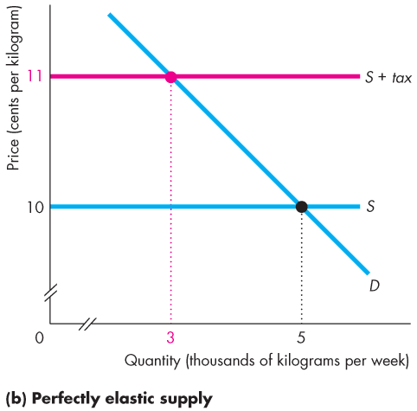
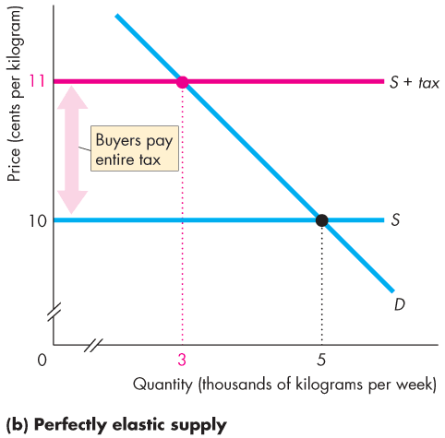
Taxes
  Perfectly Elastic Supply
  The supply of this good is perfectly elastic—the supply curve is horizontal.
  When a tax is imposed on this good, buyers pay the entire tax.

Slide 32
Taxes
Taxes in Practice
  Taxes usually are levied on goods and services with an inelastic demand or an inelastic supply.
  Alcohol, tobacco, and gasoline have inelastic demand, so the buyers of these items pay most the tax on them.
  Labour has a low elasticity of supply, so the seller—the worker—pays most of the income tax and most of the social security tax.

Slide 33
Taxes
Taxes and Efficiency
  Except in the extreme cases of perfectly inelastic demand or perfectly inelastic supply when the quantity remains the same, imposing a tax creates inefficiency.
  Figure 6.10 shows the inefficiency created by a $20 tax on MP3 players.

Slide 34
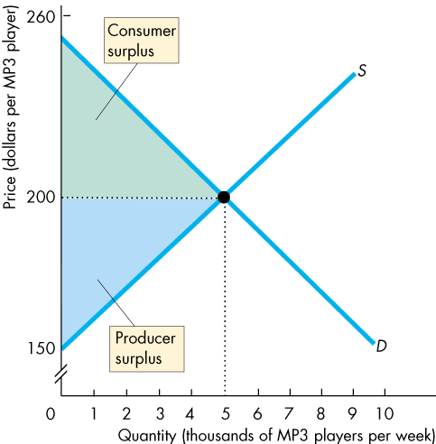
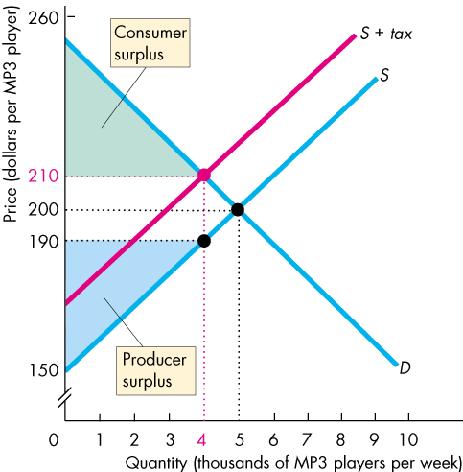
Taxes
  With no tax, marginal social benefit equals marginal social cost and the market is efficient.
  Total surplus (the sum of consumer surplus and producer surplus) is maximized.
  The tax decreases the quantity, raises the buyers’ price, and lowers the sellers’ price.

Slide 35
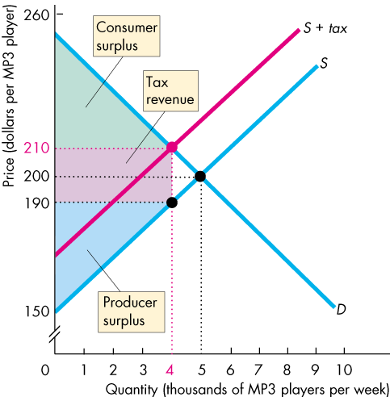
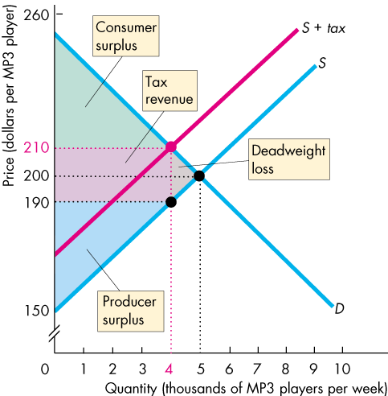
Taxes
  Marginal social benefit exceeds marginal social cost and the tax is inefficient.
  The tax revenue takes part of the total surplus.
  The decreased quantity creates a deadweight loss.
Copyright © 2013 Pearson Canada Inc., Toronto, Ontario

Slide 36
Production Quotas and Subsidies
  Intervention in markets for farm products takes two main forms:
  Production quotas
  Subsidies
  A production quota is an upper limit to the quantity of a good that may be produced during a specified period.
  A subsidy is a payment made by the government to a producer.

Slide 37
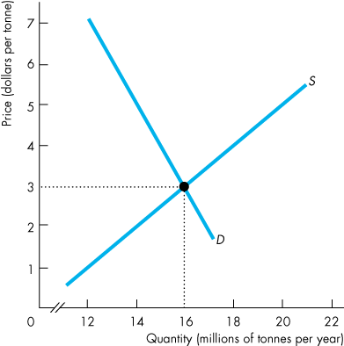
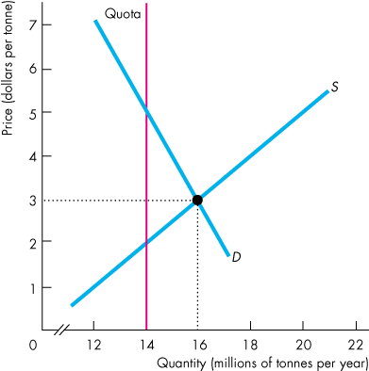




Production Subsidies and Quotas
Production Quotas
  With no quota, the price is $3 a tonne and 16 million tonnes a year are produced.
  With the production quota of 14 million tonnes a year, quantity decreases to 14 million tonnes a year.
  The market price rises to
  $5 a tonne and marginal cost falls to $2 a tonne.

Slide 38
Production Quotas and Subsidies
  Inefficiency
  At the quantity produced,
  marginal social benefit equals market price, which has increased.
  marginal social cost has decreased.
  Production is inefficient.

Slide 39



Production Subsidies and Quotas
Subsidies
  With no subsidy, the price is $40 a tonne and 40 million tonnes a year are produced.
  With a subsidy of $20 a tonne, marginal cost minus subsidy falls by $20 a tonne and the new supply curve is S – subsidy.

Slide 40



Production Subsidies and Quotas
  The market price falls to $30 a tonne and farmers increase the quantity to
  60 million tonnes a year.
  But farmers’ marginal cost increases to $50 a tonne.
  With the subsidy, farmers receive more on each tonne sold—the price of $30 a tonne plus the subsidy of $20 a tonne, which is $50 a tonne.
Copyright © 2013 Pearson Canada Inc., Toronto, Ontario

Slide 41
Production Quotas and Subsidies
  Inefficient Overproduction
  At the quantity produced:
  marginal social benefit equals the market price, which has fallen.
  marginal social cost has increased and exceeds marginal social benefit.
Copyright © 2013 Pearson Canada Inc., Toronto, Ontario

